Slide 1
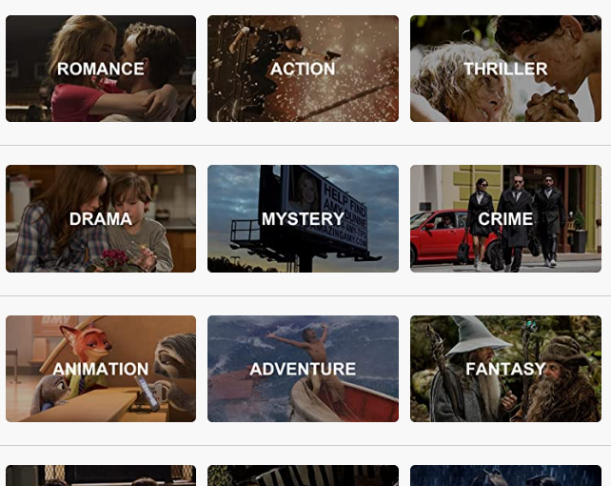
ARE ACTION MOVIES A GOOD INVESTMENT?
IF ACTION MOVIES ARE A GOOD INVESTMENT WHAT TYPE IS THE MOST PROFITABLE?

Slide 2

DICTIONARY WORDS
ROI - Return on Investment
PROI – Percentage of Return on Investment

Slide 3
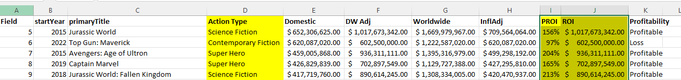
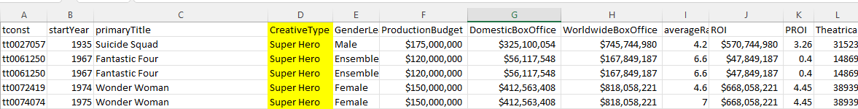
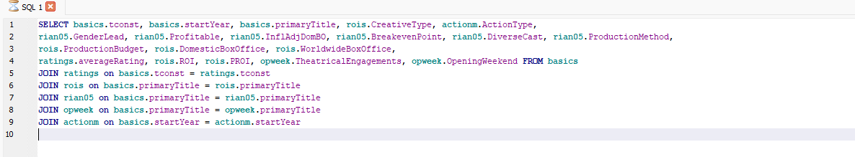
Data import and extraction
Action movie type report & ROI formulas
Super Hero movie report
JOINED REPORTS IN SQL

Slide 4
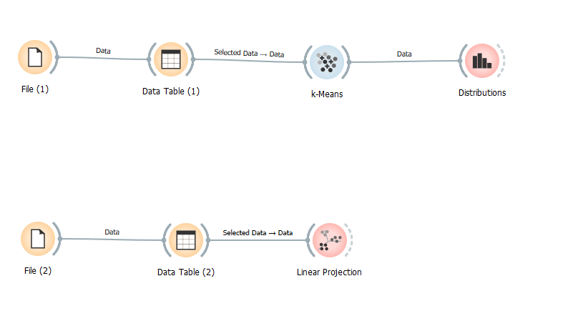
FOR STATISTICAL REVIEW OF PROFITS IN USED ORANGE A PYTHON TOOL Excel, and DB Browser to Explore and Visualize Data

Slide 5
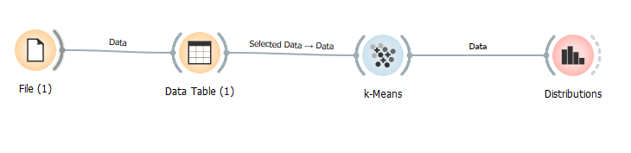
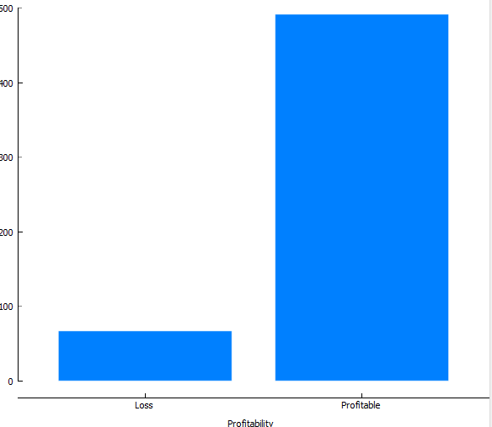
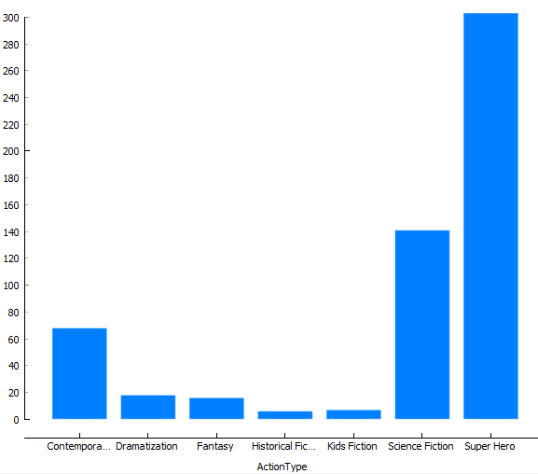
Action movies profits based on Earnings
Action movies profits by Action Movie Types

Slide 6
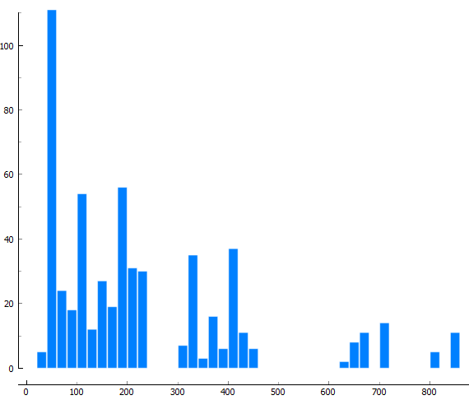
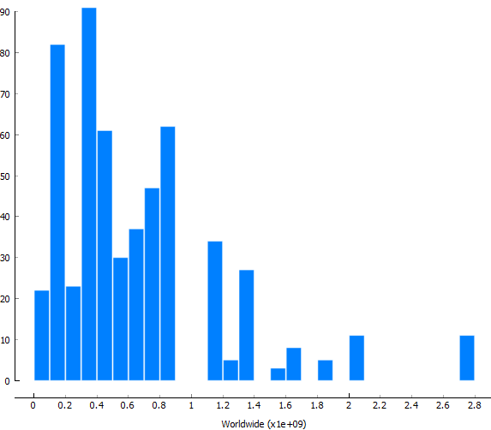
Action movies profits Domestic
Action movies profits Worldwide

Slide 7
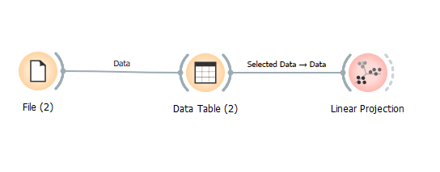
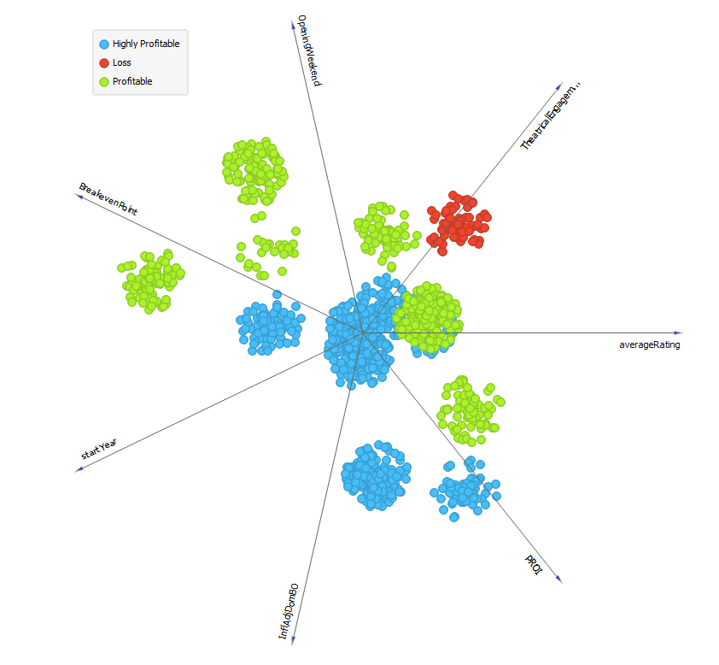
Actions movies profit influenced by following factors:
PROI
Inflation Adjustment
Average Ratings
Theatrical Eng.
Opening Week
Breakeven Point
Start Year

Slide 8
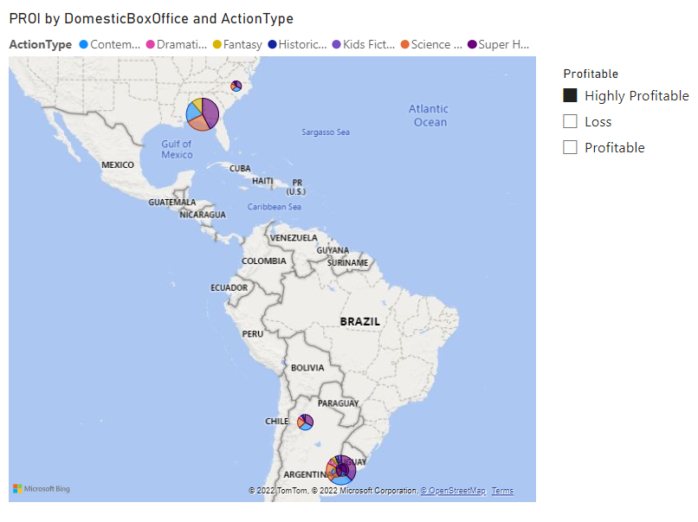
Map of most profitable Action movies
..\Desktop\DATA BOOTCAMP\Capston data\MASTER.pbix

Slide 9
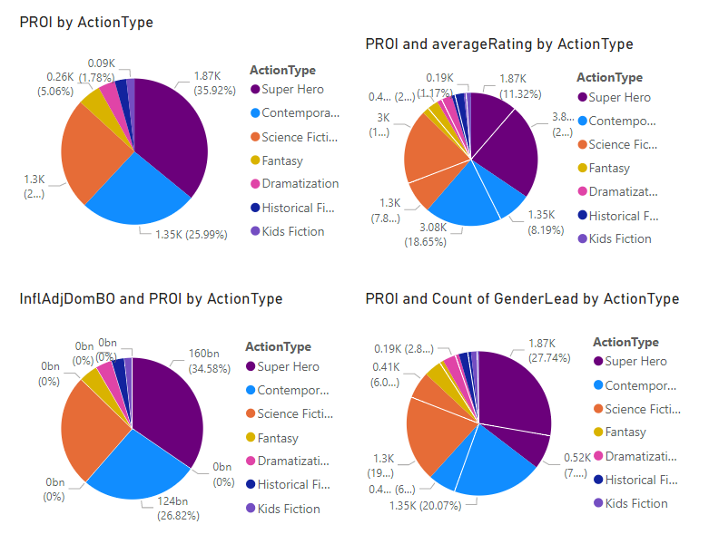
MOST PROFITABLE TYPE OF ACTION MOVIE BASTE ON PROI
PROI by:
Action Type
Ratings
Inflation Adjustments
Profitability

Slide 10
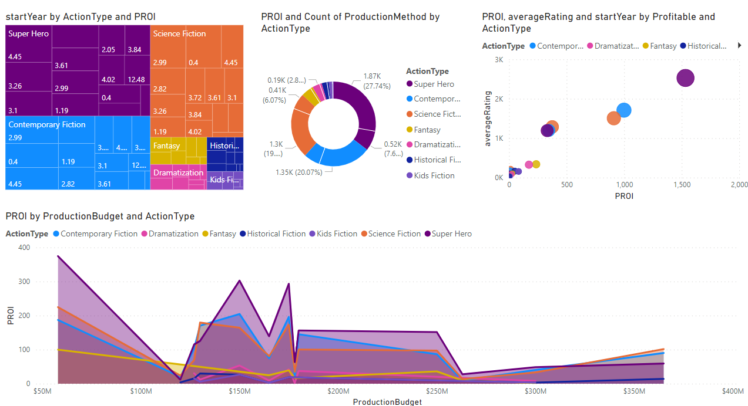
MORE PROI ANALYSIS

